Slide 1


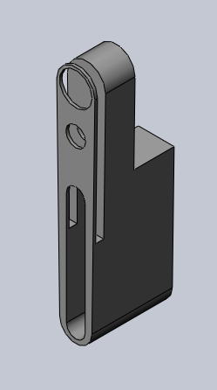
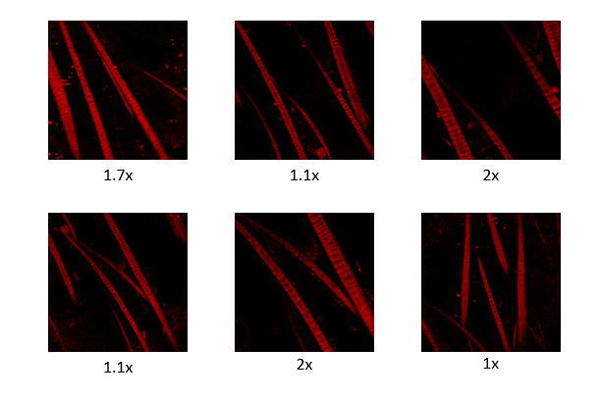
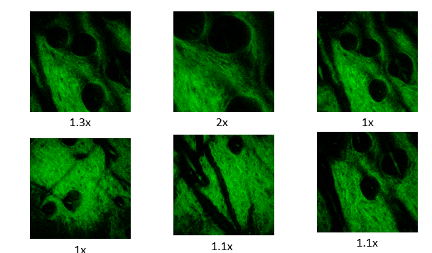
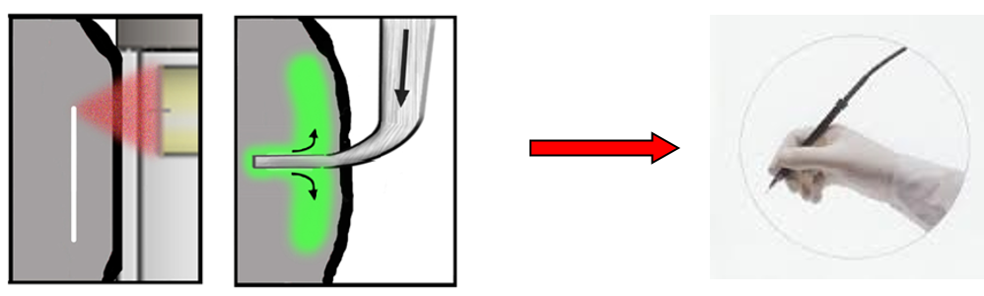
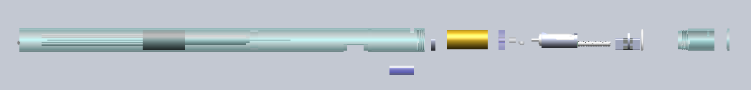
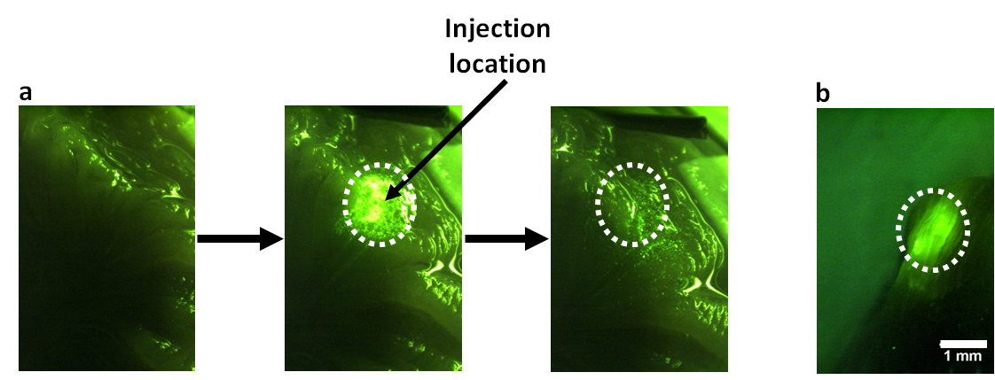

Ultrafast Laser Microsurgery Probe for Large Area Ablation
Arjun Rao¹, Murat Yildirim², Adela Ben-Yakar^{1,2†}
¹Department of Biomedical Engineering, The University of Texas at Austin, Austin, TX 78712;²Department of Mechanical Engineering, The University of Texas at Austin, Austin, TX 78712;
*Corresponding author: ben-yakar@mail.utexas.edu, Website: http://www.me.utexas.edu/ben-yakar/
Objective
III. Design of Probe
IV. In Vivo Hamster Testing
The objective of our project is to develop an ultrafast laser microsurgery probe to treat vocal fold scarring which can result from mechanical stress, overuse, or post-surgical healing.
Scarring of the vocal folds reduces mechanical compliance and can result in voice disorders. It is estimated that 4 million people in the US suffer from voice impairment due to vocal fold scarring, yet it lacks a reliable treatment¹.
localization of the biomaterials, and decreases the effectiveness of the treatment. One promising treatment involves the use of soft biomaterials aimed to restore viscoelasticity. However, in scarred vocal fold tissue, the increased tissue density causes the injection pressure to increase which hinders proper
Our proposed solution is to develop an endoscope capable of reducing the resistance of the tissue, by creating sub-epithelial voids through tissue ablation using ultra-short laser pulses^{2,3}.
The next steps in the development of this probe will be to characterize it in vivo on hamsters.
To do this we intend to clamp the hamster cheek, and perform our tests.
The cheek will be clamped, and inverted to allow access to the inside of the subject’s cheeks.
Current tests are being done on sacrificed mice and rats to ensure everything is working.
Two photon (red), and second harmonic generation (green) imaging techniques have been performed on mice and rats
All equipment has been tested.
Hamsters arrived this week.
Our probe design consists of 3 major components. They include the optical component which consists of photonic crystal fiber and lenses. The mechanical component which consists of the motors which control the movement. The third and final component is the housing.
The optical component consists of the photonic fiber and the lenses. The current design consists of one collimating lens, and an additional focusing lens to focus the light on the tissue. The fiber used in this probe is air core photonic band gap fiber. This is required to bring the light with sufficient energy for ablation.
The mechanical component consists of two motors: one to provide linear motion, and one to provide the rotational motion. The rotational motor will sit on top of the linear motor, and carry a platform containing the prism and lens. Currently most endoscopic probes do not provide linear motion.
The housing must be able to fit in the endoscope (17x16x16mm triangle) while still providing room for the other equipment the surgeon may require. Our design of a cylinder with a radius of 6mm leaves ample space for the other equipment.
The challenge facing the development of this probe is that there is a lack of means to flexibly deliver the light to clinical sites, and patients.
Additionally, the fiber must be able to deliver high power laser pulses at high repetition rates. This minimizes the ablation time for such a large field of view.
To address this issue, a unique photonic crystal fiber with an air core will be used.
We are developing an ‘Ultrafast Laser Scalpel’ which will be able to deliver the light to clinical sites and patients.
Design of the housing component of the probe. The SQUIGGLE motor, Micromo, and the platform can be seen on the right side in blue.
An Handheld Ultrafast Laser Scalpel
V. Conclusions
II. Table-Top Studies
Currently tests are being performed in hamsters.
We will test scarring methods on hamsters.
Scarring methods include electro-cautery and laser scarring.
Imaging methods will be tested.
Goal: To test the feasibility of biomaterial injection into subeptihlelial void
Current design of probe. Adjustments to ensure precision include advanced alignment system and spring to assist in return to original position.
Injection of PEG30 biomaterial into scarred tissue with and without ablation. Fluorescence images of a injection without ablation, from left to right: before injection, just after the injection, and after cleaning the tissue
VI. References
S. Hirano, "Current treatment of vocal fold scarring," Curr Opin Otolaryngol Head Neck Surg 13(3), 143-147 (2005).
C. L. Hoy, W. N. Everett, M. Yildirim, J. Kobler, S. M. Zeitels and A. Ben-Yakar, "Towards endoscopic ultrafast laser microsurgery of vocal folds," J Biomed Opt 17(3), 038002 (2012).
Yildirim, M., O. Ferhanoglu, J. Kobler, S.M. Zeitels, and A. Ben-Yakar, “Parameters affecting ultrafast laser microsurgery of sub-epithelial voids for scar treatment in vocal folds,” Journal of Biomedical Optics, 18 (11), 118001 – 14 (2013)
Hoy, C.L., W.N. Everett, M. Yildirim, J. Kobler, S. M. Zeitels, and A. Ben-Yakar, “Towards endoscopic ultrafast laser microsurgery of vocal folds,” Journal of Biomedical Optics 17, 038002 (2012).
Hoy, C.L., O. Ferhanoglu, M. Yildirim, K.H. Kim, S.S. Karajanagi, K.M.C. Chan, J. Kobler, S.M. Zeitels, and A. Ben-Yakar, “Clinical ultrafast laser surgery: recent advances and future directions,” Invited Review Paper, IEEE Journal of Selected Topics in Quantum Electronics on Nanophotonics, in press (2014).
surface showing that it was not possible to inject and localize the biomaterial inside the scar tissue. The dashed lines indicate the region of injection. b Injection into an ablated void of 2x1 mm² size after wiping of tissue surface⁵.

